Slide 1
Java Server Faces (JSF)
Suleman Khurram

Slide 2
What is JSF?
Java Server Faces (JSF) is a Java-based web application framework intended to simplify development integration of web-based user interfaces. JavaServer Faces is a standardized display technology, which was formalized in a specification through the Java Community Process.
A basic understanding of Java programming language, text editor, and execution of programs etc will be required. Since we are going to develop web-based applications using JSF, it will be good if you have an understanding of other web technologies such as HTML, CSS, AJAX, etc

Slide 3
Overview
JavaServer Faces (JSF) is a MVC web framework that simplifies the construction of User Interfaces (UI) for server-based applications using reusable UI components in a page.
JSF provides a facility to connect UI widgets with data sources and to server-side event handlers. The JSF specification defines a set of standard UI components and provides an Application Programming Interface (API) for developing components.
JSF enables the reuse and extension of the existing standard UI components.

Slide 4
How is it useful for us?
It provides clean and clear separation between behavior and presentation of web application. You can write business logic and user interface separately.
JavaServer Faces APIs are layered directly on top of the Servlet API. Which enables several various application use cases, such as using different presentation technologies, creating your own custom components directly from the component classes.
Including of Facelets technology in JavaServer Faces 2.0, provides massive advantages to it. Facelets is now the preferred presentation technology for building JavaServer Faces based web applications.

Slide 5
JSF UI Component Model
JSF provides the developers with the capability to create Web application from collections of UI components that can render themselves in different ways for multiple client types (for example - HTML browser, wireless, or WAP device).
Core library
A set of base UI components - standard HTML input elements
Extension of the base UI components to create additional UI component libraries or to extend existing components
Multiple rendering capabilities that enable JSF UI components to render themselves differently depending on the client types

Slide 6
Build tools
Build tools are programs that automate the creation of executable applications from source code (e.g., .apk for an Android app). Building incorporates compiling,linking and packaging the code into a usable or executable form.

Slide 7
Build tools
Basically build automation is the act of scripting or automating a wide variety of tasks that software developers do in their day-to-day activities like:
Downloading dependencies.
Compiling source code into binary code.
Packaging that binary code.
Running tests.
Deployment to production systems.

Slide 8
Why do we use build tools?
In small projects, developers will often manually invoke the build process. This is not practical for larger projects, where it is very hard to keep track of what needs to be built, in what sequence and what dependencies there are in the building process. Using an automation tool allows the build process to be more consistent.

Slide 9
Build Tool Types
Some of the common Java build tools are
Maven
Ant
Gradle

Slide 10
What is ANT?
ANT stands for Another Neat Tool
Apache ANT is a Java based build tool from Apache Software Foundation
Apache ANT’s build files are written in XML and they take advantage of being open standard, portable and easy to understand.
On an average, a developer spends a substantial amount of time doing mundane tasks like build and deployment that include −
Compiling the code
Packaging the binaries
Deploying the binaries to the test server
Testing the changes
Copying the code from one location to another
To automate and simplify the above tasks, Apache Ant is useful. It is an Operating System build and deployment tool that can be executed from the command line.

Slide 11
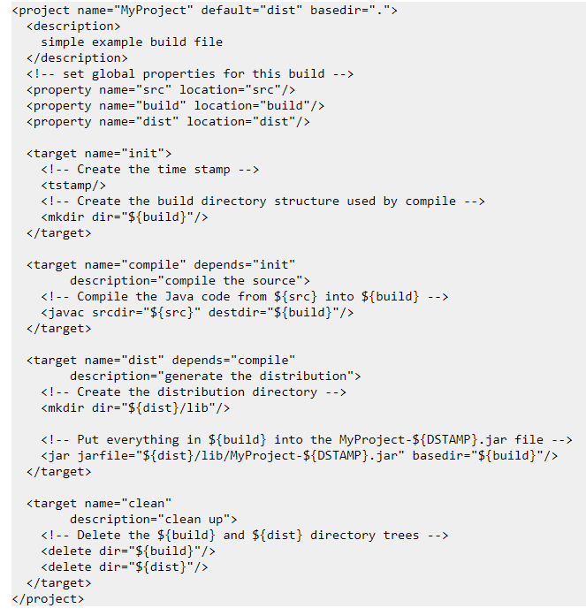

Slide 12
What is Maven?
Apache Maven is a software project management and comprehension tool. Based on the concept of a project object model (POM), Maven can manage a project's build, reporting and documentation from a central piece of information. Using maven we can build and manage any Java based project.
As most of the project setups are simple and reusable, Maven makes life of developer easy while creating reports, checks, build and testing automation setups.
Maven provides developers ways to manage the following −
Builds
Documentation
Reporting
Dependencies
SCMs
Releases
Distribution
Mailing list

Slide 13
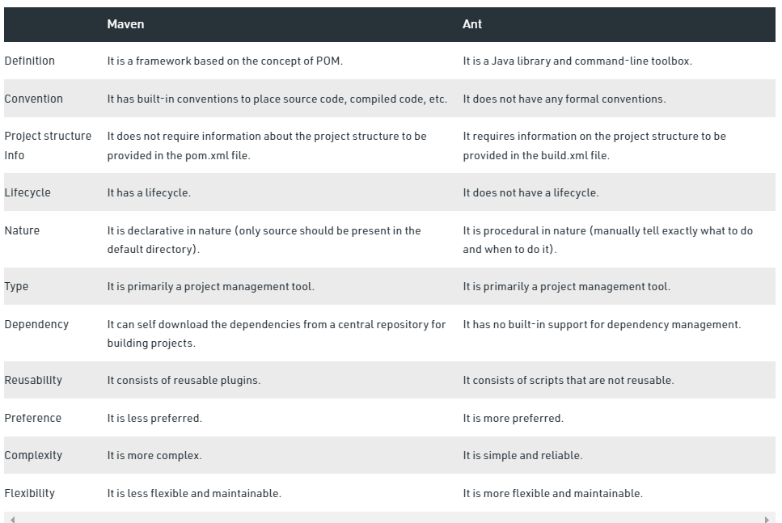

Slide 14
Web Development
If you develop a web application (independent of the programming language you are using), you typically put your web application on a dedicated server (and not your local computer). The web application runs on the server and people can access it there. The server is either a real machine (with CPU, memory, harddisk, etc.) or a virtual server which is basically a machine which is separated by software into smaller machines.
Java web applications are typically not running directly on the server. Java web applications are running inside a web container on the server.
The container provides a runtime environment for Java web applications. The container is for Java web applications what the JVM (Java Virtual Machine) is for local running Java applications. The container itself runs in the JVM.

Slide 15
Web server vs Application server
Web Server is designed to serve HTTP Content. App Server can also serve HTTP Content but is not limited to just HTTP. It can be provided other protocol support such as RMI/RPC
Web Server is mostly designed to serve static content, though most Web Servers have plugins to support scripting languages like Perl, PHP, ASP, JSP etc. through which these servers can generate dynamic HTTP content.
Most of the application servers have Web Server as integral part of them, that means App Server can do whatever Web Server is capable of. Additionally App Server have components and features to support Application level services such as Connection Pooling, Object Pooling, Transaction Support, Messaging services etc.
As web servers are well suited for static content and app servers for dynamic content, most of the production environments have web server acting as reverse proxy to app server. That means while servicing a page request, static contents (such as images/Static HTML) are served by web server that interprets the request. Using some kind of filtering technique (mostly extension of requested resource) web server identifies dynamic content request and transparently forwards to app server

Slide 16
Common java servers
Web server
Apache Tomcat
Application Servers
Glassfish
Wildfly
JBoss

Slide 17
What do we need?
In our work, we will be using following tools for configuration and running of a JSF application.
JDK 16.0
Eclipse IDE
Wildfly 23.0.2 Final
Maven build
JSF Configuration in Maven

Slide 18
Configuring Java
Download JDK from the given link http://jdk.java.net/java-se-ri/16. Note that this link is specifically for JDK 16.
Put your java binaries downloaded from the given link, in the location you want. For the reference we will call it JAVA_HOME.
In your environment variables, create a variable named JAVA_HOME and put the path of java directory as value of that variable(created in step 2) For example ‘c:\Program Files\java\jdk'.
In PATH variable add ‘JAVA_HOME\bin’ entry in the end. For example ‘c:\Program Files\java\jdk\bin’
Open command prompt and type ‘java -version’ to check your java installation.

Slide 19
Installation and Configuration of Eclipse IDE
Download Eclipse from the given link (https://www.eclipse.org/downloads/)
After downloading the executable file, you will need to install it with default configurations. Note that you will need to install “Eclipse for Enterprise and J2EE applications developer”

Slide 20
Installation and Configuration of Maven
Download Maven latest version from https://maven.apache.org/download.cgi
Extract the archive, to the directory you wish to install Maven 3.8.4. The subdirectory apache-maven-3.8.4-bin will be created from the archive.
Add MAVEN_HOME to system variables.
MAVEN_HOME=C:\Program Files\Apache Software Foundation\apache-maven-3.8.4-bin
Add bin directory of Maven installation in PATH System variable.
Append the string “;C:\Program Files\Apache Software Foundation\apache-maven-3.8.4-bin\bin” to the end of the system variable, Path.
Now open console and execute the following mvn command.
mvn --version

Slide 21
Installation and Configuration of Wildfly
Download Wildfly 23.0.2 from this link https://www.wildfly.org/news/2021/04/29/WildFly2302-Released/
After successfully downloading the zipped file. Unzip it in the appropriate location
One of the common directory structures of Wildlfy is “C\WildflyAS\Unzipped wildfly folder”
You don’t need to do any installation or setting for this server yet, we will be using it in the Eclipse IDE.

Slide 22
Wildfly Integration in Eclipse IDE
We will be installing the JBoss Tools plugin on Eclipse so that you can manage e local or remote WildFly application server without leaving your IDE.
Move to the Help | Eclipse Market Place and enter in the search box “JBoss Tools”. You will see several JBoss Tools releases available. Choose to install or update the latest stable JBoss Tools plugin:

Slide 23
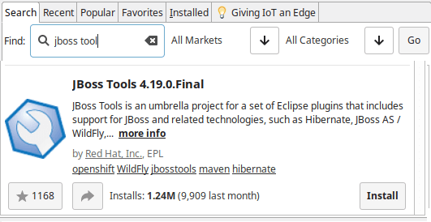

Slide 24
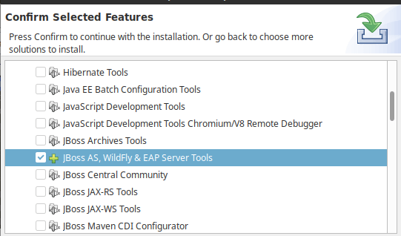
In the next screen select the “JBoss AS, WildFly & EAP Server tools” plugin and restart Eclipse once completed.

Slide 25
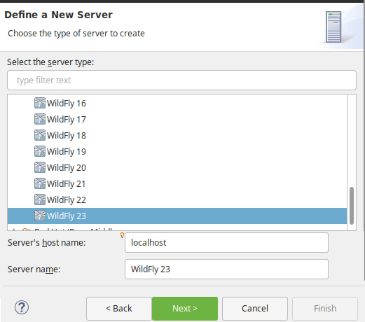
Now choose from the upper Menu: File | New | Server and expand the JBoss Community option. A “WildFly” Server is included:

Slide 26
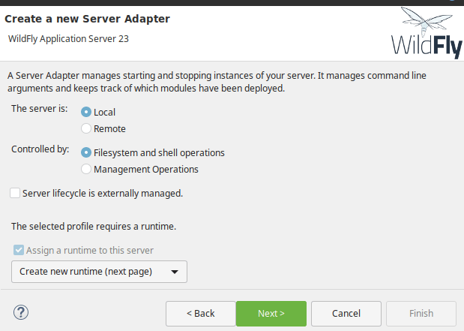
In the next screen you have to choose if the Server is locally installed (Local) or it’s a remote server (Remote) and how the Server Lifecycle is managed:

Slide 27
Finally, point to the location where the application server is installed, the JRE execution environment and the configuration file to be used (default is standalone.xml) :
Click Finish. WildFly is now configured on your Eclipse environment!
Click on the Icons in the toolbar to Debug / Start / Profile / Stop your Server. Right click on it and choose “Add or Remove ” to Deploy applications on it.

